Slide 1
PYTHON FUNDAMENTAL COURSE
Coach by
Tan Nguyen

Slide 2
COURSE OBJECTIVES
Basic understanding about python and programing languages
Understand about data structure, build function, OOP (class)
Use AI/Chat GPT to speed up code learning
Can use very important library for data analysis and machine learning such as Sklearn, Scipy, Numpy, Dataframe and Matplotlib, Streamlit
Can build mini data analysis and machine learning project
Notes:
Khi bạn chạy file .py, Python sẽ:
Đọc từng dòng mã nguồn
Dịch và thực thi từng dòng một bằng interpreter (trình thông dịch)
Khi bạn viết chương trình C (.c) và biên dịch (compile):
Mã nguồn được chuyển trực tiếp thành mã máy (machine code) bởi compiler (ví dụ: gcc)
Kết quả là 1 file chạy độc lập (thường là .exe trên Windows hoặc binary trên Linux)

Slide 3
COURSE CONTENTS
Introduction to python
Variable and data type
Operator and control flow
Data structure
Data analysis library
Numpy
Pandas
Mathplotlib
Lasio
Streamlit
Class (OOP)
Machine learning projects

Slide 4
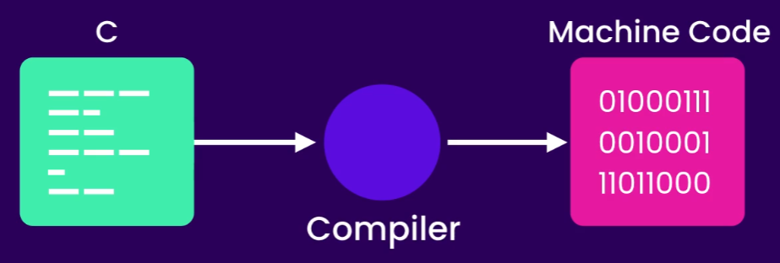
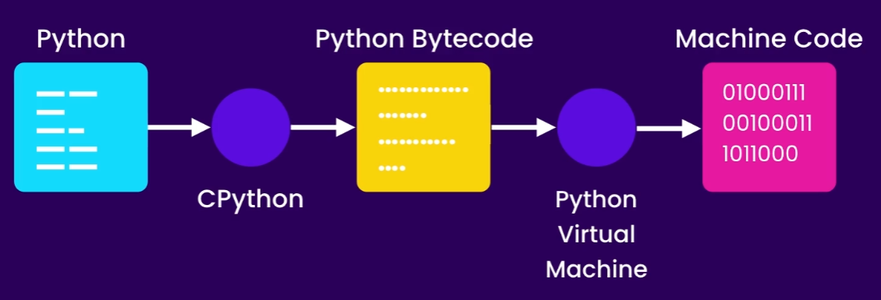
PROGRAMMING LANGUAGE
A programming language is how humans "talk" to computers to make them do things.
Type of programming languages:
High level: python, java, java script, c,c++
Low level: assembly, machine language
Interpreter: read code line by line and run on-the-fly
Complier: convert all source code in machine code then execute.
Source: codewithmosh
Notes:
Khi bạn chạy file .py, Python sẽ:
Đọc từng dòng mã nguồn
Dịch và thực thi từng dòng một bằng interpreter (trình thông dịch)
Khi bạn viết chương trình C (.c) và biên dịch (compile):
Mã nguồn được chuyển trực tiếp thành mã máy (machine code) bởi compiler (ví dụ: gcc)
Kết quả là 1 file chạy độc lập (thường là .exe trên Windows hoặc binary trên Linux)

Slide 5
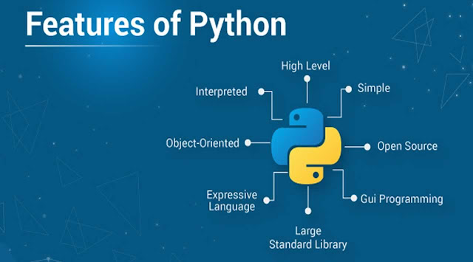
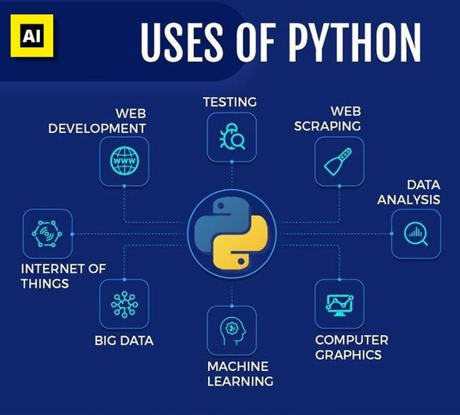
WHY PYTHON?

Slide 6
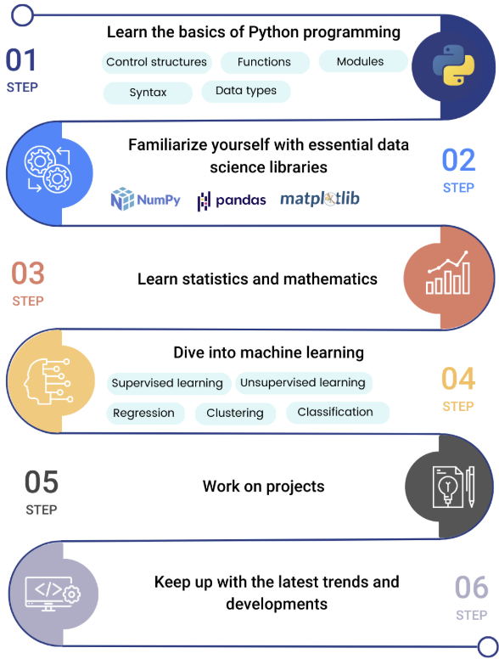
ROAD MAP
Source: datasciencedojo.com

Slide 7
VARIABLE AND DATA TYPES

Slide 8
VARIABLES
Definition:
Variable in Programming is a named storage location that holds a value or data. These values can change during the execution of a program, hence the term "variable." Variables are essential for storing and manipulating data in computer programs. A variable is the basic building block of a program that can be used in expressions as a substitute in place of the value it stores. (source: geeksforgeeks.org)
Declaration:
phie = 0.25
swe= 0.5
facies = “Sand”
is_checked=True
Types of variable:
Global variable: global variables can be accessed in any part of the program
Local variable: are only accessible within that limited context

Slide 9
VARIABLES NAMING NOTES
Python is case-sensitive language
Variables names must:
Start with underscore ( _ ) or letter ( a-z A-Z )
Followed by any number of underscores ( _ ), letters ( a-z A-Z ), or digits ( 0-9 )
Not use reserved words for variable name

Slide 10
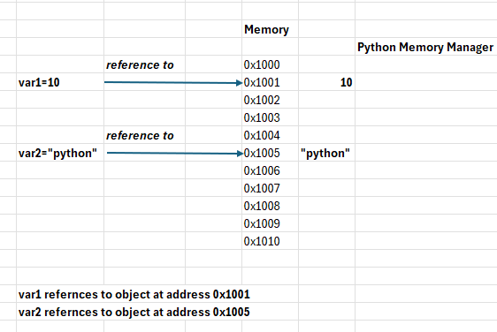
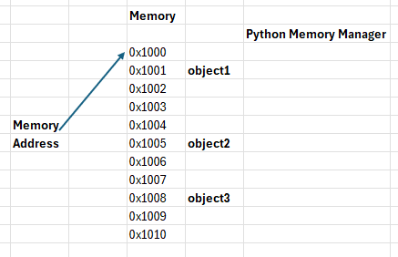
VARIABLE IMPORTANT NOTES
Variables in python are memory references

Slide 11
STATIC TYPING
Some languages (C++, Java) are statically typed
0x1000
String
myVar
String
hello
Reference
String | myVar | =“hello”
Data type | Variable name | Value (Java)
Data type is associated with variable name
If we then declare: myVar=10→Error!
Dim | myVar | As String
(VB6) | Variable name | Data Type
Source: Python deep dive course

Slide 12
DYNAMIC TYPING
Python is dynamically typed
0x1000
myVar
String
hello
Reference
0x1005
New Reference
integer
100
Data type is not associated with variable name
If we then declare: myVar=10→the variable change its reference to new memory address (no error)
Source: Python deep dive course

Slide 13
DATA TYPES AND METHODS
Strings
Numbers
Boolean
Excercise

Slide 14
OPERATORS AND CONTROL FLOWS

Slide 15
ARITHMETIC OPERATORS
Operator | Description | Example | Result
+ | Addition | 3 + 2 | 5
- | Subtraction | 5 - 2 | 3
* | Multiplication | 4 * 3 | 12
/ | Division (float) | 10 / 4 | 2.5
// | Floor Division | 10 // 4 | 2
% | Modulus (remainder) | 10 % 3 | 1
** | Exponentiation | 2 ** 3 | 8

Slide 16
COMPARISON OPERATORS
Operator | Description | Example | Result
== | Equal to | 3 == 3 | True
!= | Not equal to | 4 != 5 | True
> | Greater than | 5 > 3 | True
< | Less than | 2 < 7 | True
>= | Greater or equal | 5 >= 5 | True
<= | Less or equal | 4 <= 6 | True

Slide 17
ASSIGNMENT OPERATORS
Operator | Description | Equivalent To
= | Assign value | x = 5
+= | Add and assign | x += 3 → x = x+3
-= | Subtract and assign | x -= 2 → x = x-2
*= | Multiply and assign | x *= 4 → x = x*4
/= | Divide and assign | x /= 2 → x = x/2
//= | Floor divide and assign | x //= 2
%= | Modulus and assign | x %= 3
**= | Power and assign | x **= 2

Slide 18
LOGICAL/MEMBERSHIP/IDENTITY OPERATORS
Operator | Description | Example | Result
and | True if both true | True and False | False
or | True if at least one is true | False or True | True
not | Negate the condition | not True | False
Operator | Description | Example | Result
in | Returns True if in container | 'a' in 'apple' | True
not in | Returns True if not in container | 'x' not in 'data' | True
Operator | Description | Example | Result
is | True if same object in memory | x is y | True / False
is not | True if different objects | x is not y | True / False

Slide 19
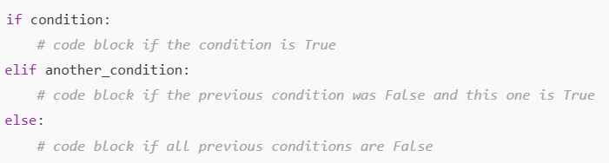
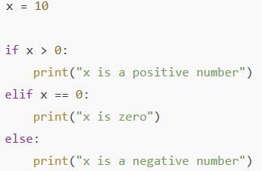
IF-ELSE
Example:

Slide 20
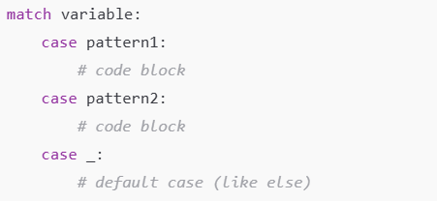
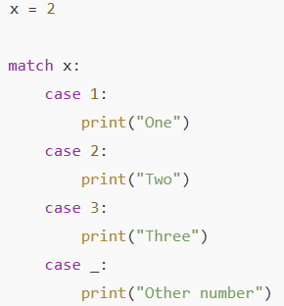
MATCH-CASE

Slide 21
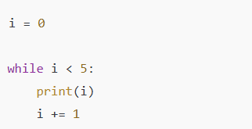
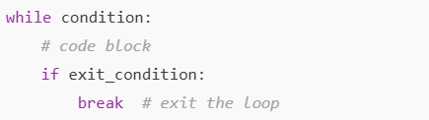
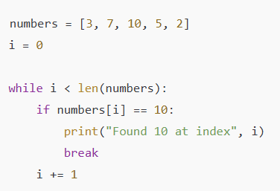
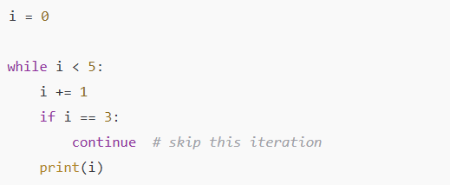
WHILE

Slide 22
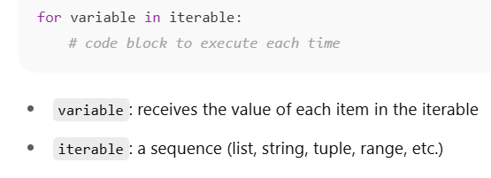
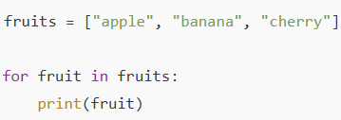
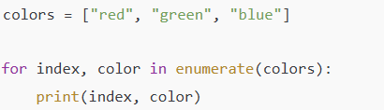
FOR LOOP

Slide 23
DATA STRUCTURES

Slide 24
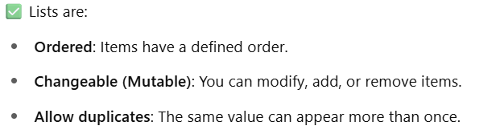
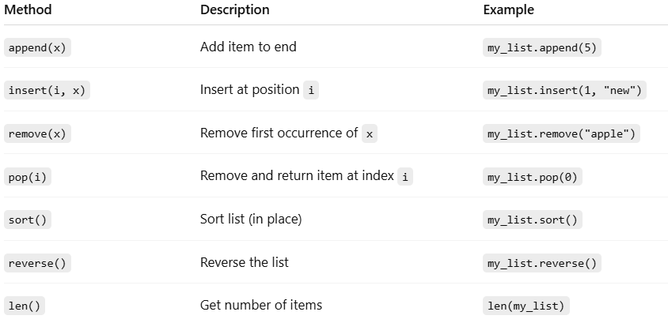
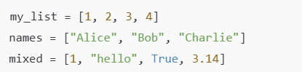
LIST

Slide 25
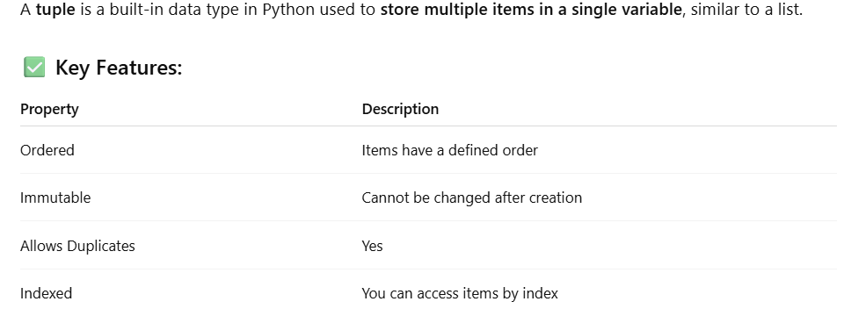
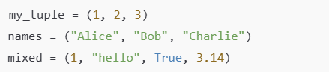
TUPLE

Slide 26
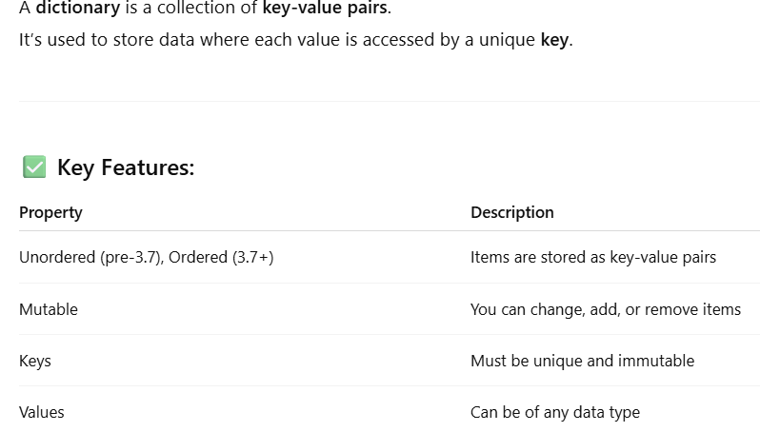
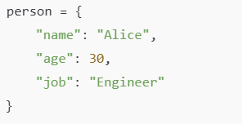
DICTIONARY

Slide 27
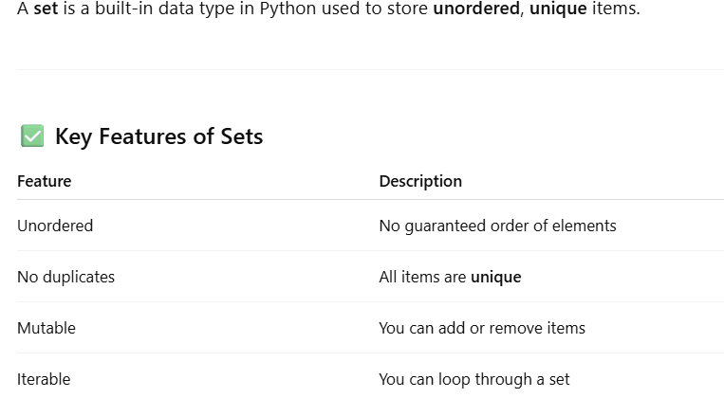
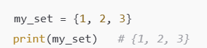
SET

Slide 28
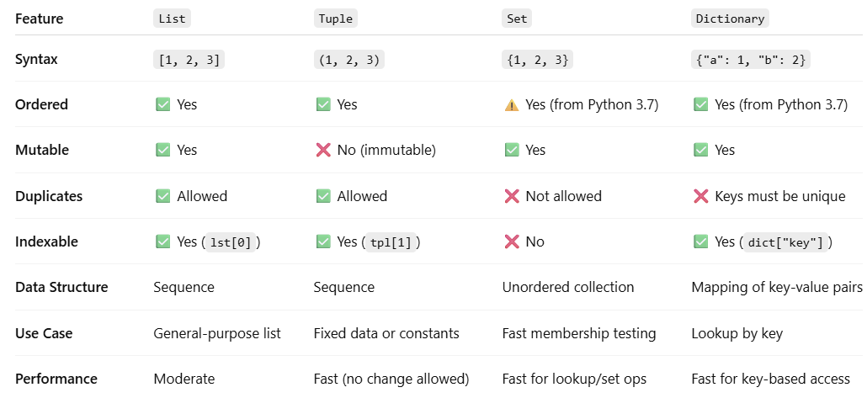
COMPARISON

Slide 29
MUTABLE AND IMMUTABLE
Changing the data inside the object is called modifying the internal state of the object.
The object which its data can be changed call MUTABLE OBJECT and vice versus.
type
State
(data)
0x1000
Object in memory
Memory address not changed!
0x1000
0x1000
BankAccount
Act: 123
Balance:500
BankAccount
Act: 123
Balance:1500
my_account
Data changed!
Source: Python deep dive course

Slide 30
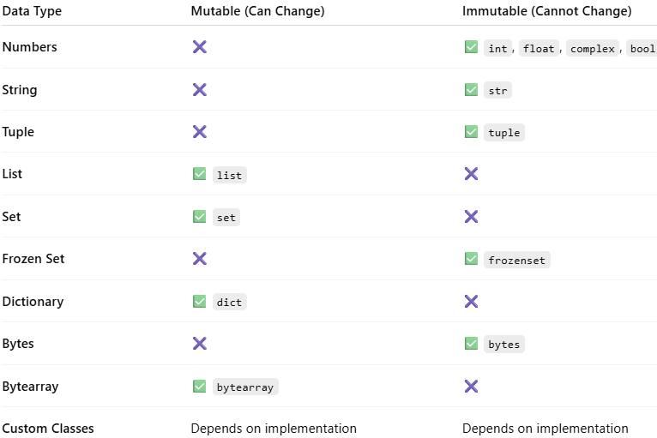
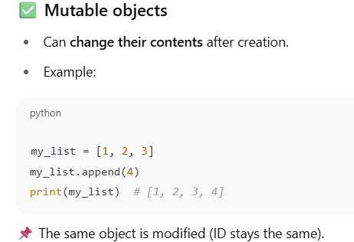
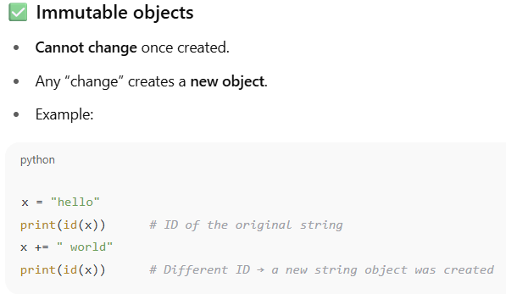
MUTABLE AND IMMUTABLE OBJECTS

Slide 31
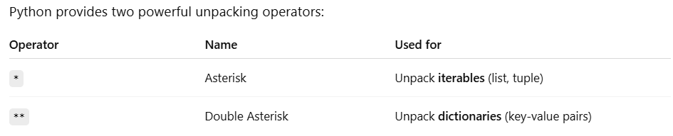
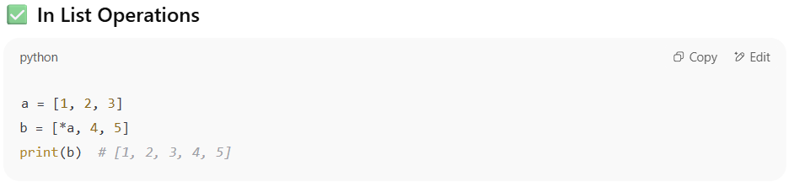
UNPACKING OPERATORS

Slide 32
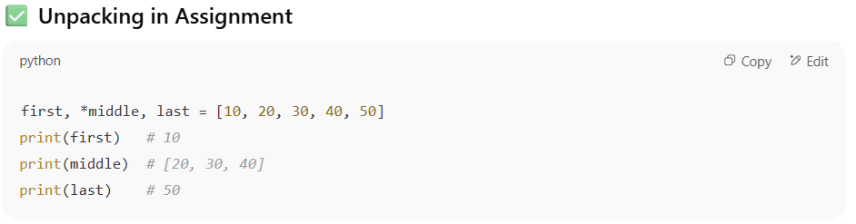
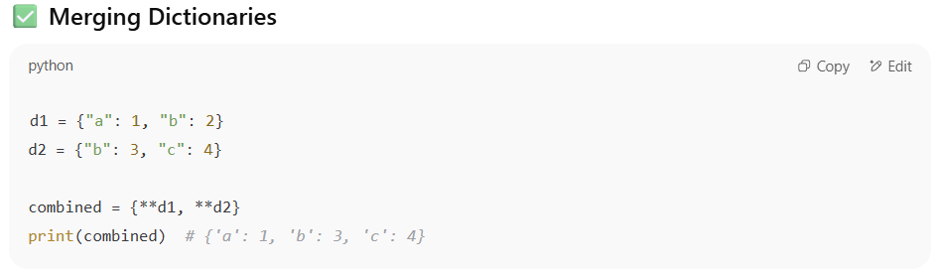
UNPACKING OPERATORS

Slide 33
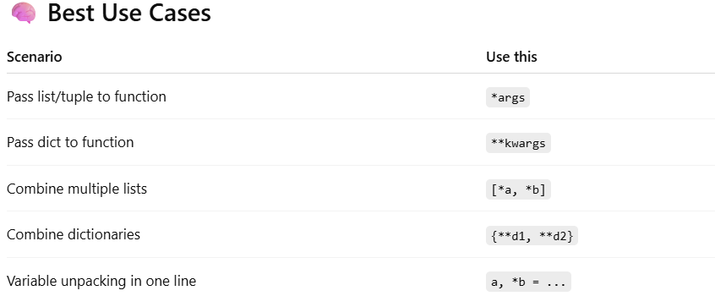
UNPACKING OPERATORS

Slide 34
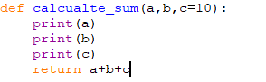
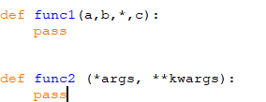
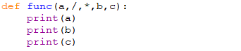
FUNCTIONS
a,b is positional arguments of function
c is keyword argument of function

Slide 35
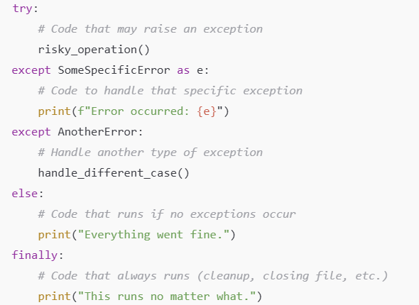
ERROR HANDLING STRUCTURE

Slide 36
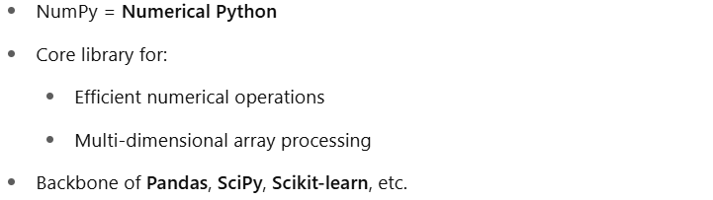
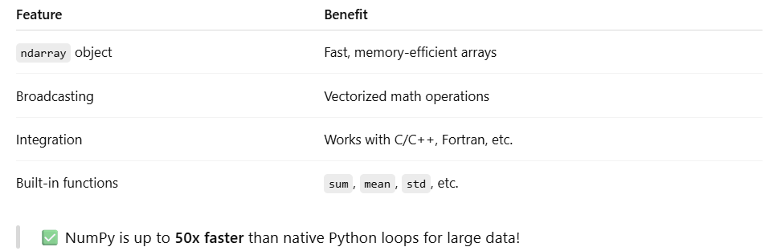
NUMPY

Slide 37
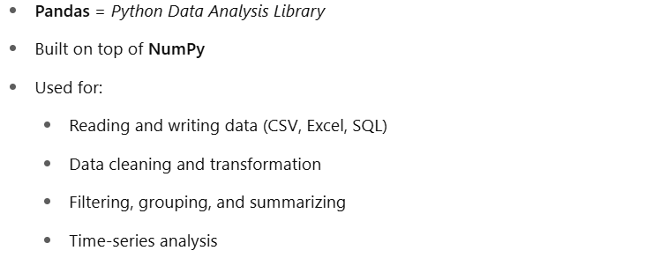
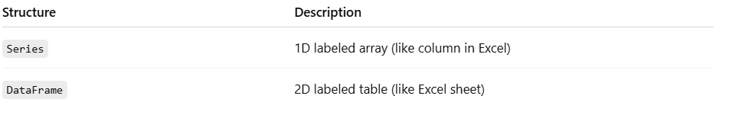
PANDAS

Slide 38
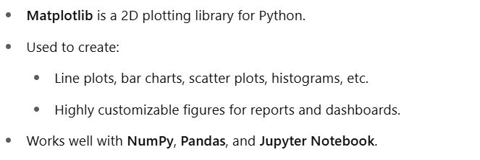
MATPLOTLIB

Slide 39
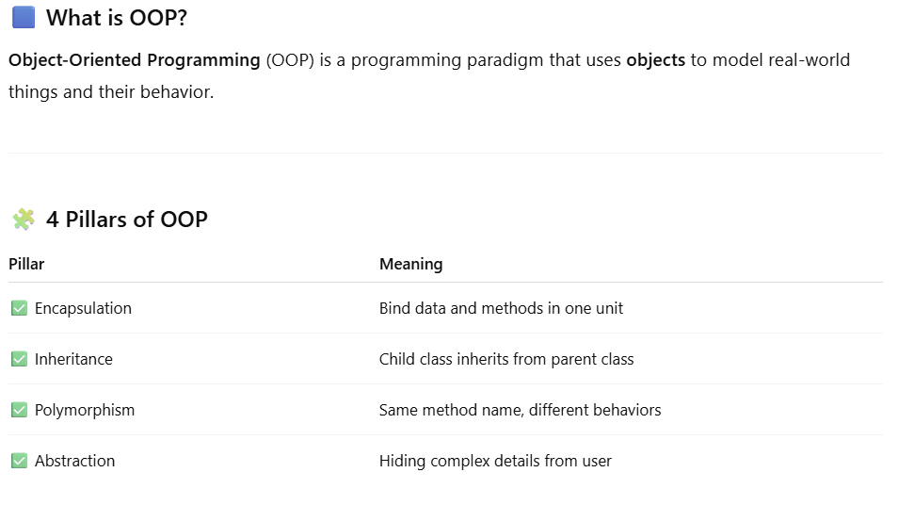
CLASS

Slide 40
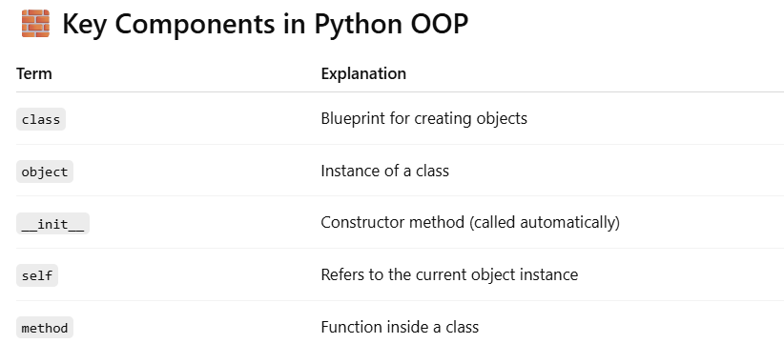
CLASS

Slide 41
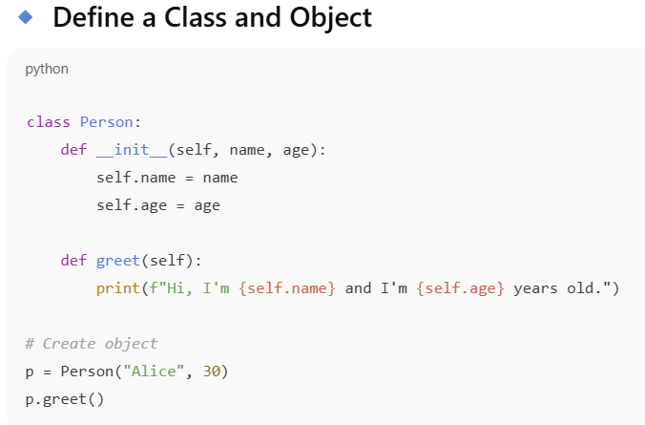
CLASS

Slide 42
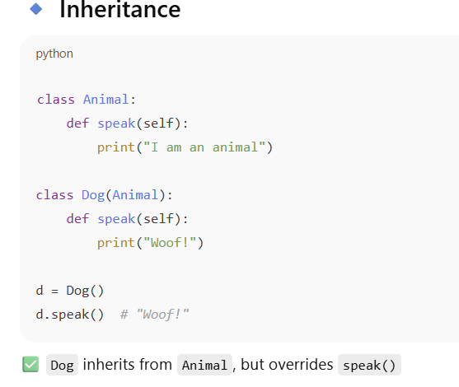
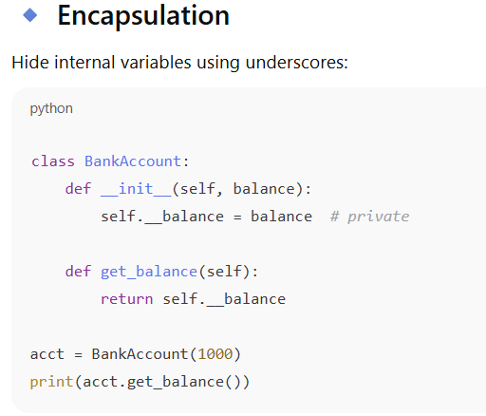
CLASS

Slide 43


CLASS

Slide 44


CLASS

Slide 45

https://data-flair.training/blogs/machine-learning-tutorial/
What Is Machine Learning?
Machine Learning is popular technique of predicting the future or classifying information to help people in making necessary decisions
Machine Learning algorithms are trained over instances or examples through which they learn from past experience and also analyze the historical data
Notes:
Machine Learning cơ bản là một mô hình có khả năng “học tập” một lượng lớn dữ liệu, đọc được những khuôn mẫu (pattern) trong dữ liệu và thực hiện một nhiệm vụ nào đó, có thể là đưa ra những phân loại, dự đoán. Có thể hiểu đơn giản là giống như cách con người học, “máy học” cũng là quá trình huấn luyện máy tính dựa trên những dữ liệu, khuôn mẫu đã có nhằm hoàn thành một công việc trong tương lai một cách tốt hơn mà con người không cần thủ công can thiệp.

Slide 46

How Machine Learning Work?
https://data-flair.training/blogs/machine-learning-tutorial/

Slide 47



Type of Machine Learning
Supervised learning : train dataset is labeled (input +output)
Unsupervised Learning: deals with the unlabeled data
https://data-flair.training/blogs/machine-learning-tutorial/

Slide 48

STEPS
Import the data
Clean the data
Split the data into Training/Test Sets
Create a model
Train the model
Make predictions
Evaluate and Improve
Source: codewithmosh

Slide 49




THANK YOU!

